Slide 1


Yusuf Ardahan Dogru
22 September 2024

Slide 2

Outline
Executive Summary
Introduction
Methodology
Results
Conclusion
Appendix

Slide 3
Executive Summary
Data collection was done on SpaceX data with the help of SpaceX API and Wikipedia scraping. Exploratory Data Analysis was done to get an initial understanding of the data with scatter plots, bar and line charts.
An interactive map and dashboard was created with Folium and Plotly Dash. Lastly, predictive analysis was done with the help of various machine learning models for the classification of launch outcomes given the other data.
The models performed with high accuracy on the test set, supplemented by the optimization of hyperparameters and the understanding of the data from the data science methodology

Slide 4
Introduction
SpaceX offers a significantly lower cost of $62 million per Falcon 9 rocket launch compared to the $165 million charged by its competitiors. A key factor in this cost difference is the reuse of the first stage of the rocket.
By accurately predicting the landing of the first stage, the overall launch cost can be estimated. This data is valuable in various scenarios, such as when a competitor seeks to bid against SpaceX for a rocket launch contract.
We wanted to find if there’s a way to predict first stage landing by looking at the data provided by SpaceX.
The factors which affect the probability of the landing is also an import question to answer.

Slide 5

Section 1

Slide 6
Methodology
Executive Summary
Data collection methodology:
Perform data wrangling
Exploratory data analysis (EDA) using visualization and SQL
Interactive visual analytics using Folium and Plotly Dash
Predictive analysis using classification models

Slide 7
Data Collection
SpaceX launch data was gathered from the SpaceX REST API.
The API contained data about launches, including but not limited to rocket information, delivered payload, launch and landing specifications, and landing outcome.
Differing data needed for the analysis was obtained through endpoints stemming from ‘https://api.spacexdata.com/v4/’

Slide 8
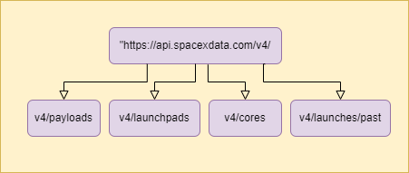
Data Collection – SpaceX API
Booster name was extracted from v4/rockets, payload mass and destination orbit information was extracted from v4/payload, launch site data was extracted from v4/launchpads, etc.
The following link can be used to access the GitHub URL: SpaceX API Calls

Slide 9
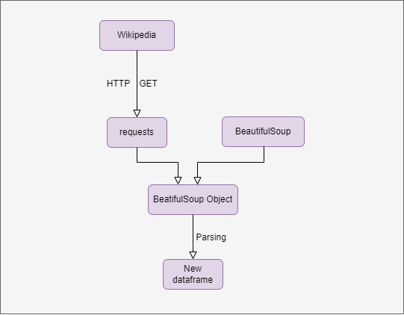

Data Collection - Scraping
BeautifulSoup library was used to extract Falcon 9 launch records from Wikipedia, which was stored in a HTML table.
Information parsed from the HTML table was stored in a dataframe for the next step.
Access to the notebook for reference: Web Scraping from Wikipedia

Slide 10
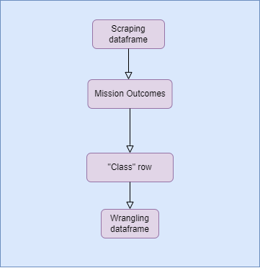
Data Wrangling
Data was processed to generate a new column in the dataframe.
The new column, Class, is a binary variable that represent the classification variable that represents the outcome of each launch.
Access to the notebook for reference: Data Wrangling

Slide 11
EDA with Data Visualization
Scatter plots demonstrating the relationships between pairs of variables were generated.
Flight number, launch site, payload mass, orbit, landing outcome, were compared with each other, to get an idea of how each of these factors influenced each other.
Class column was plotted against year in a line graph to get a clear visualization of how the success rate of landings changed throughout the years.
A bar chart was plotted using orbit and class data to identify which orbits have the highest success rates.
For reference: EDA with Data Visualization

Slide 12
EDA with SQL
Various SQL queries were performed to get a better idea about the data:
The total number of successful and failed mission outcomes were queried.
Failed landing outcomes in 2015 were queried, shown month by month, also displaying booster version and launch site information.
The count of successful and failed landings between 4 June 2010 and 28 March 2017 were ranked in descending order.
The total payload mass carried by boosters launched by NASA was queried.
Average payload mass carried by version F9 v1.1 booster was displayed.
For reference: EDA with SQL

Slide 13
Interactive Map with Folium
All launch sites existing in the data was marked with a small circle, along with text and pop-ups to display where the launch sites are located on the map.
For each launch site, successful and failed launches were marked to clearly show which sites had better success rate. Successful launches were marked with green and failed launches were marked with red, emphasizing the outcome.
Lines were drawn from launch sites to proximities such as coastline, to give a sense of distance in the map.
For reference: Interactive Folium Map

Slide 14
Dashboard with Plotly Dash
The dashboard contains a pie graph, a scatter plot, a dropdown menu for selecting the launch site, and a slider for determining the payload mass limits.
The pie graph shows the number of successful launches for every launch site, or a specific launch site chosen by the dropdown menu. This allowed a quick way of comparing launch numbers and success percentage between launch sites.
The success of the launches was plotted against the payload mass in the scatter plot, and colored with the booster type to display the role of payload mass and booster type in the success percentage of rocket launches.
For reference: Plotly Dash Dashboard

Slide 15
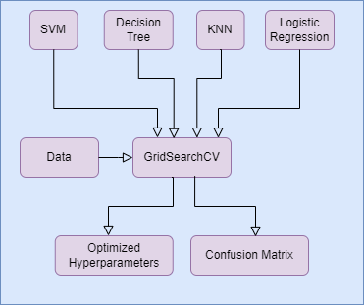
Predictive Analysis (Classification)
Class column from the spaceX dataframe was designated as the target variable as the model was designed to predict the outcome of a launch.
Data was standardized and split into train and test sets.
Logistic regression, SVM, decision tree and KNN models were trained using the train data while using GridSearch to optimize the hyperparameters.
Model performance was assessed using test accuracy and confusion matrix.
For reference: Machine Learning Predictions

Slide 16
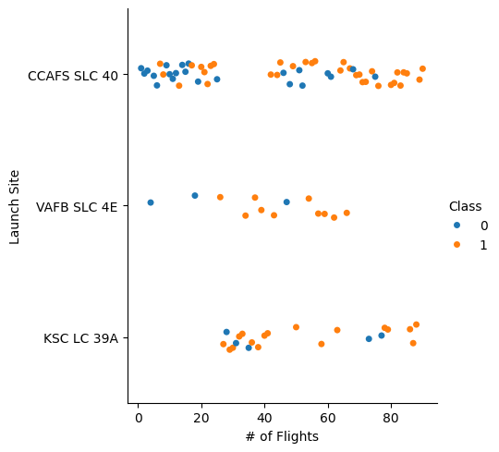
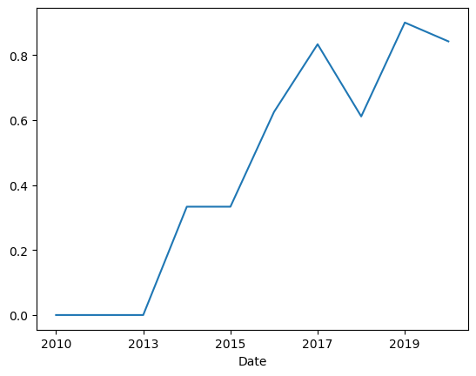
Results - EDA
A trend of increasing success with higher flight numbers was observed for each launch site(orange dots are successes)
Success rate has kept increasing since 2013

Slide 17
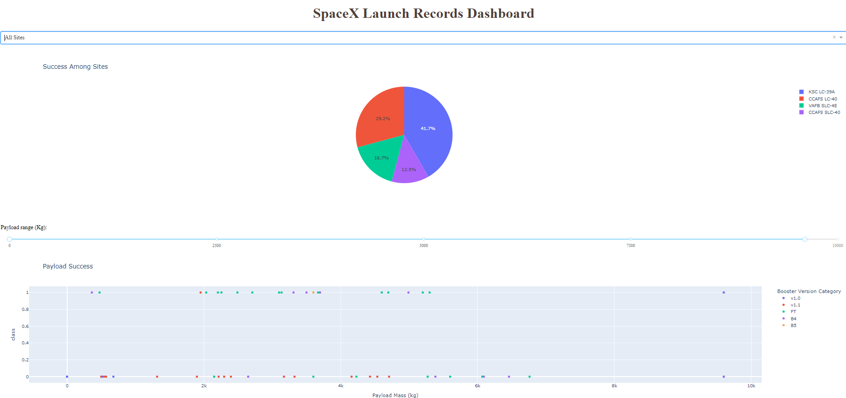
Results – Interactive Analytics

Slide 18

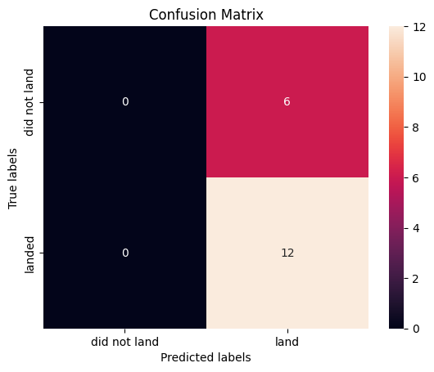
Results – Predictive Analysis
Logistic regression, SVM, decision tree and KNN models were trained and tuned to achieve good accuracy on the test data. Some confusion matrices gained as a result are:

Slide 19

Section 2

Slide 20
Flight Number vs. Launch Site
For various launch sites, there was a clear affect of the number of flights on the outcome of mission success.
In general, a trend of increasing success with increasing flight numbers were observed.

Slide 21
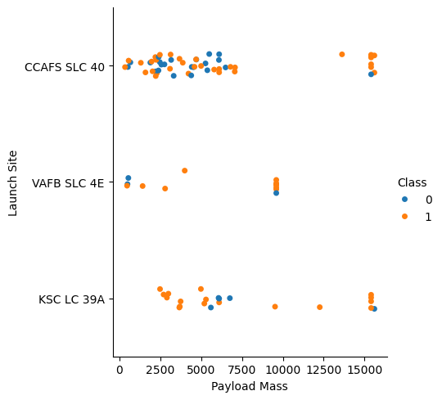
Payload vs. Launch Site
The payload mass’ effect was not so clear on the mission outcome, at least for the three launch sites in the graph.
Especially for KSC LC 39A and CCAFS SLC 40, there were many successes with both low and high payload mass

Slide 22
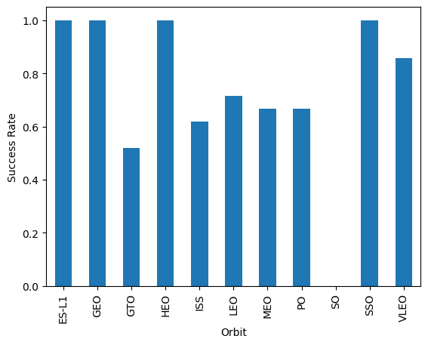
Success Rate vs. Orbit Type
The orbit SO had no success for some reason.
Some orbits, GTO, ISS, LEO, MEO, and PO had non-adequate success rate, between 50 and 70 percent.
Other orbits like ES-L1, GEO, HEO, SSO, VLEO showed good success rates between 80 and 100 percent

Slide 23
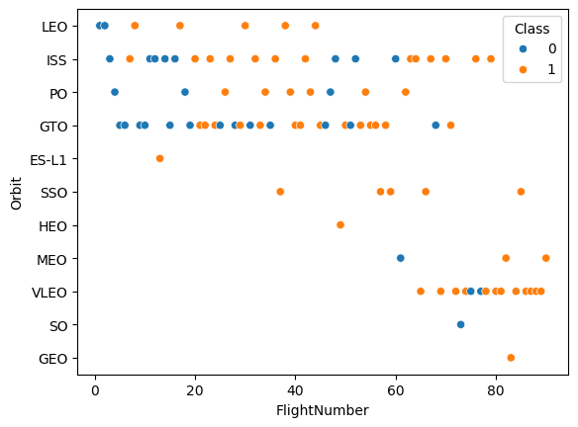
Flight Number vs. Orbit Type
A general trend of increasing success with increasing flight number was observed among most of the Orbit types.
Some orbits had a small amount of data and cannot said to have a relation with the flight number.

Slide 24
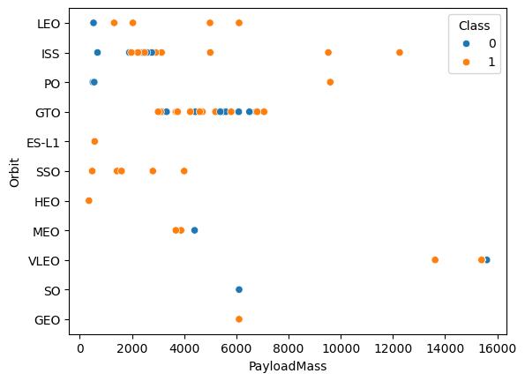
Payload vs. Orbit Type
A general trend of increasing success with increasing payload mass was observed among most of the Orbit types.
Some orbits had a small amount of data and cannot said to have a relation with the payload mass.

Slide 25
Launch Success Yearly Trend
Success rate has increased along the years with increasing flight numbers

Slide 26
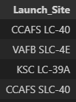
All Launch Site Names
Names of the unique launch sites in the dataset
were queried.
There were 4 unique sites home to rocket launches

Slide 27
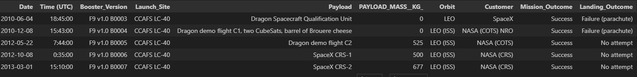
Launch Site Names Begin with 'CCA'
5 records where launch sites begin with `CCA` were queried.
No ordering was done.

Slide 28
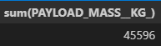
Total Payload Mass
Total payload carried by boosters from NASA were calculated.

Slide 29
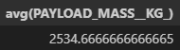
Average Payload Mass by F9 v1.1
The average payload mass carried by booster version F9 v1.1 was calculated.

Slide 30
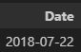
First Successful Ground Landing Date
The date of the first successful landing outcome on ground pad were found.

Slide 31
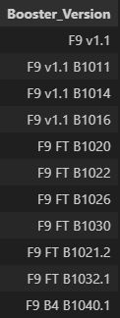
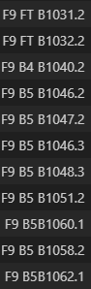
Successful Drone Ship Landing with Payload between 4000 and 6000
The names of boosters which have successfully landed on drone ship and had payload mass greater than 4000 but less than 6000 were listed.

Slide 32
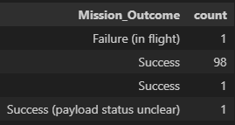
Total Number of Successful and Failure Mission Outcomes
The total number of successful and failure mission outcomes were calculated.

Slide 33
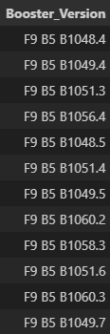
Boosters Carried Maximum Payload
The names of the booster which have carried the maximum payload mass were listed.

Slide 34
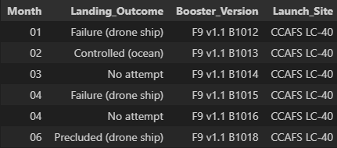
2015 Launch Records
The failed landing outcomes in drone ship, their booster versions, and launch site names for in year 2015 were listed.

Slide 35
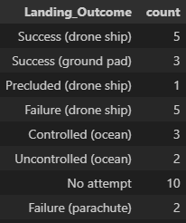
Rank Landing Outcomes Between 2010-06-04 and 2017-03-20
The count of landing outcomes (such as Failure (drone ship) or Success (ground pad)) between the date 2010-06-04 and 2017-03-20, were ranked in descending order.

Slide 36

Section 3

Slide 37
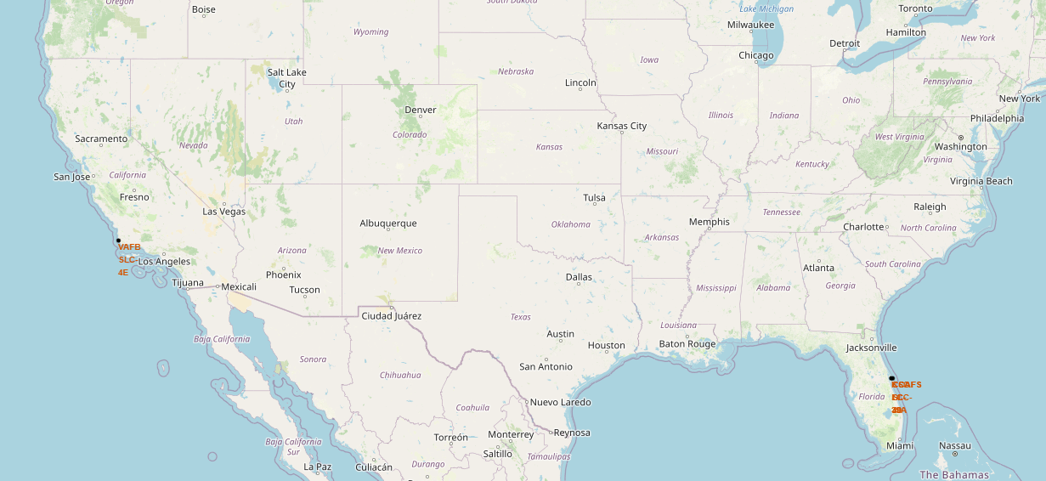
Launch Sites Marked on Map
The unique launch sites in the dataset was marked on the Folium map with circle markers and pop-ups, labeled with their name. Three sites were nearly in the same place, which is the reason for the cramped text on the right.

Slide 38
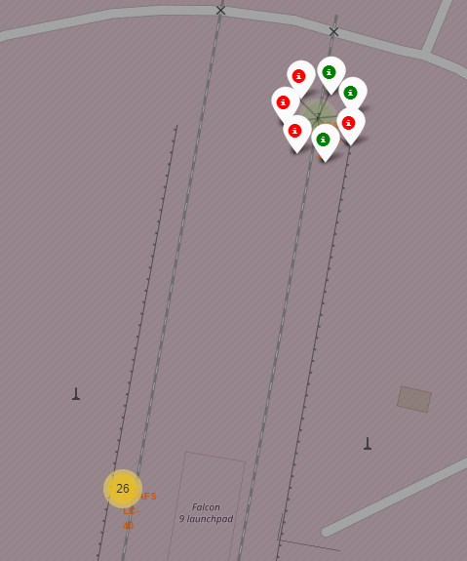
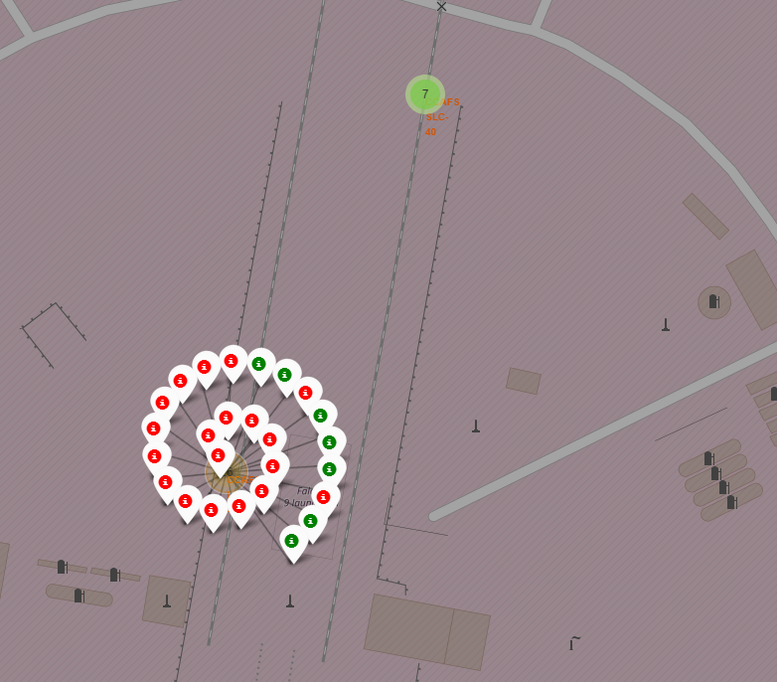
Success of the Launch Outcomes Marked on Map
Each launch was marked with red for an unsuccessful launch and with green for a successful launch. The marks can be seen by clicking on the launch site markers.

Slide 39
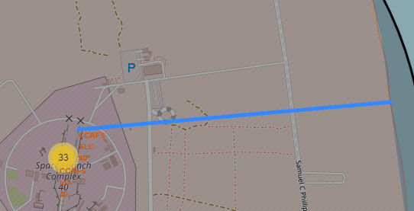
Lines to Proximities from Launch Sites
The generated folium map was marked with lines that show the distances to its proximities such as railways and coastlines.

Slide 40

Section 4

Slide 41
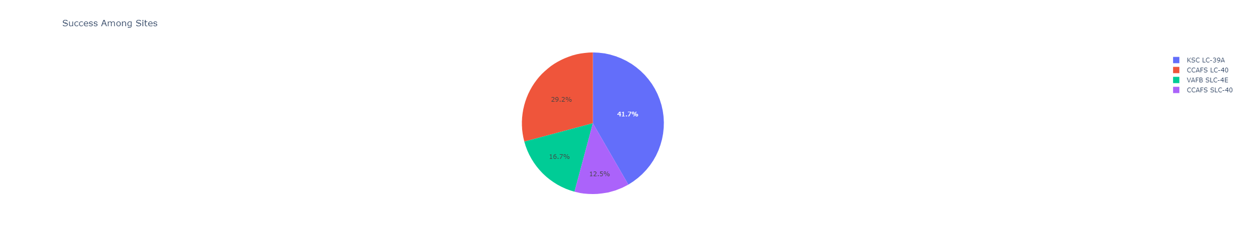
Launch Success Count Pie Chart
The total amount of launch successes grouped by the launch sites is generated by the Dashboard on default.

Slide 42

Launch Site With the Highest h success ratio
The pie chart demonstrates the launch site with the highest success ratio,
CCAFS-SLC-40, selected from the dropdown menu on the dashboard.

Slide 43
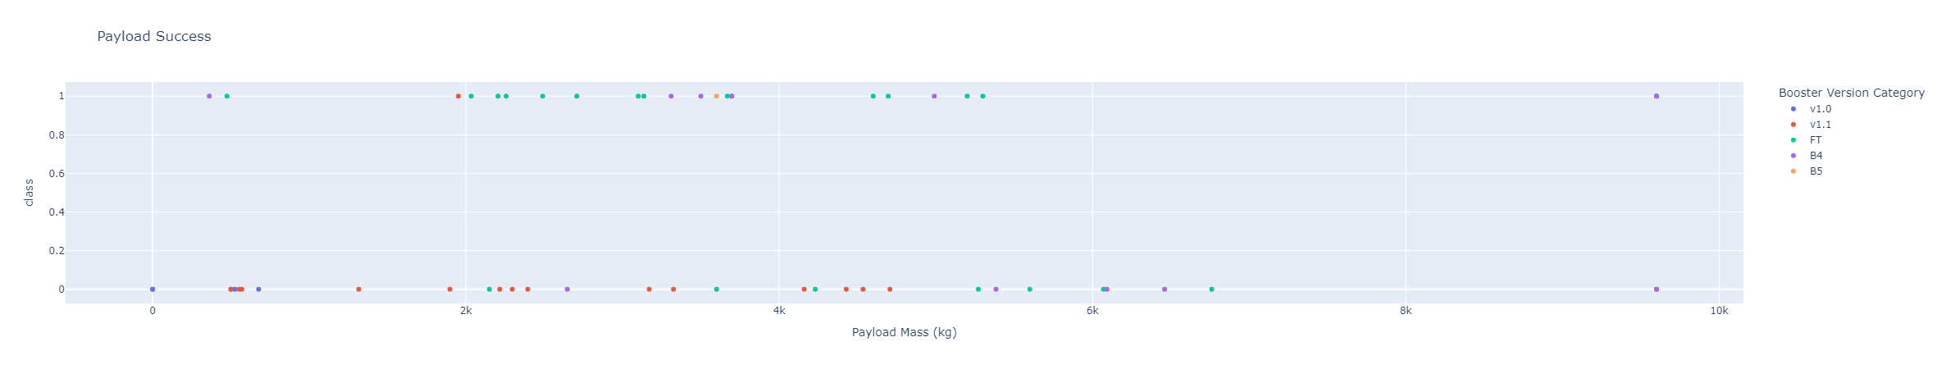
Payload vs. Launch Outcome for all Sites
The scatterplot is shown by default with different payload range selected in the range slider, showing outcomes for different booster versions.
It is clear that the turquoise dots are more common for those of class 1, or those with successful launches. Therefore, it can be inferred that the booster version FT boasts the best success rate, at least for the payload mass range between 2k and 6k

Slide 44

Section 5

Slide 45
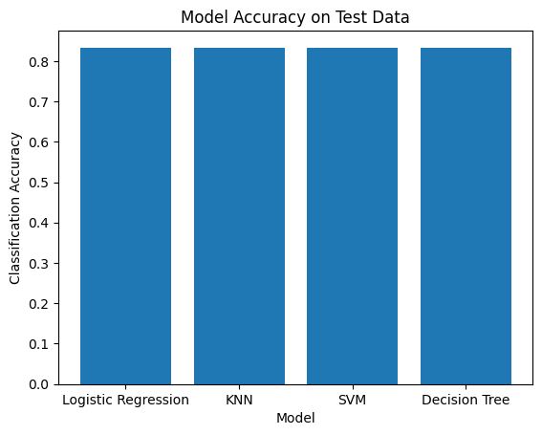
Classification Accuracy
Built model accuracy was the same for all 4 models, and all performed with good accuracy over 80%.

Slide 46

Confusion Matrix
Here is the KNN model’s confusion matrix.
It was able to predict 12 successful landings and 3 failed landings correctly.
It classified 3 failed landings as successful but no successful landings as failed, which points to the fact that it is biased towards successful landings.

Slide 47
Conclusions
The outcome of the first stage landing can be predicted with high accuracy from the given data and generated models.
Among all the different models, all models performed similarly with high accuracy on the test set and similar accuracies on the training set.
Since the data is made out of mostly successful landings, the models were biased to predict a landing as successful rather than failed.

Slide 48


